Slide 1
Financial Aid
2023 – 2024

Slide 2
Todays Topics
Things we will cover:
What is financial aid?
Cost of attendance (COA)
Expected family contribution (EFC)
Financial need
Categories, types, and sources of financial aid
Free Application for Federal Student Aid (FAFSA)
Special circumstances

Slide 3
Financial Aid
What is Financial Aid?
Financial aid consists of a variety of funds including scholarships, grants, loans and work-study that help pay for a student's postsecondary educational expenses.

Slide 4
COA
What is Cost of Attendance?
COA includes:
Tuition & Fees
Room & Board
Books & Supplies
Transportation
Personal Expenses
Direct v. Indirect Costs
COA Varies widely from college to college

Slide 5
EFC
What is Expected Family Contribution?
Amount family can reasonably be expected to contribute
Stays the same regardless of college
Two components
Parent contribution
Student contribution
Calculated using data from a federal application form and a federal formula

Slide 6
Need
What is Financial Need?
Cost of Attendance
– Expected Family Contribution
= Financial Need

Slide 7
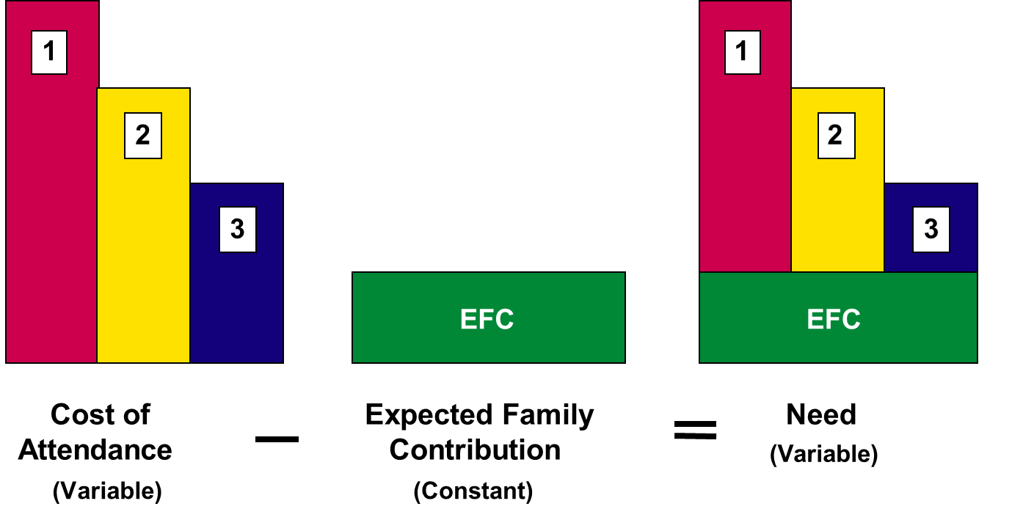
Need Varies Based on Cost

Slide 8
Types Financial Aid
Gift Aid
Scholarships
Grants
Self-Help Aid
Loans
Employment

Slide 9
Sources of Financial Aid
Federal government
States
Colleges and universities
Private sources
Civic organizations and churches
Employers

Slide 10
Grants
Pell Grants – Based on EFC
Automatic with eligibility
2022-2023 maximum annual award amount $6,895
FSEOG
Supplemental grant for the neediest of students
Based on availability
State Grants
Alabama Student Grant
Alabama Student Assistant Grant

Slide 11
Work Study
Federal Work Study
Federal dollars paid in exchange for part-time employment in designated jobs
School comes first
Institutional Work Study

Slide 12
Loans
Federal Direct Loans
Subsidized
Unsubsidized
Freshman Annual Loan Limit = $5500
2022-2023 Interest Rate = 4.99%
Parent PLUS Loans
2022-2023 Interest Rate = 7.54%
Private/Alternative Loans
Elmselect.com

Slide 13
Free Application for Federal Student Aid (FAFSA)
FAFSA on the Web (FOTW)
myStudentAid mobile app
Paper or PDF FAFSA
FAFSA on the Phone (FOTP)
FAA Access to CPS Online

Slide 14
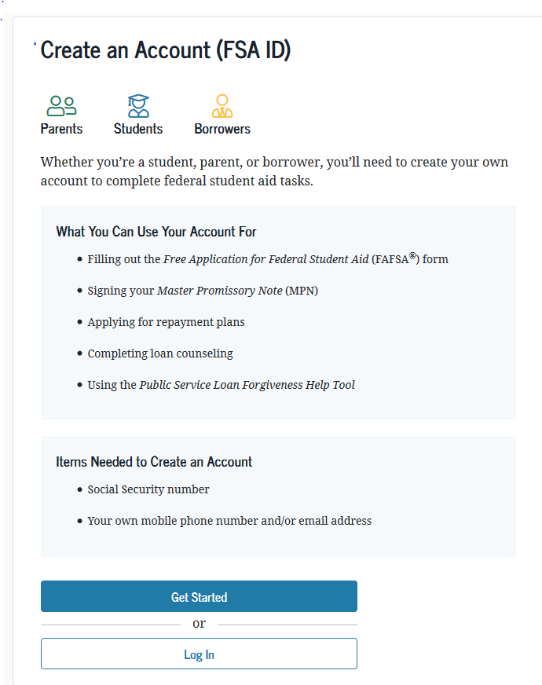
FSA ID
Used for FAFSA completion and allows access to certain U.S. Department of Education websites
May be used by students and parents throughout financial aid process, including subsequent school years
Only the owner should create a FSA ID
Apply at https://studentaid.gov/fsa-id/create-account/launch

Slide 15
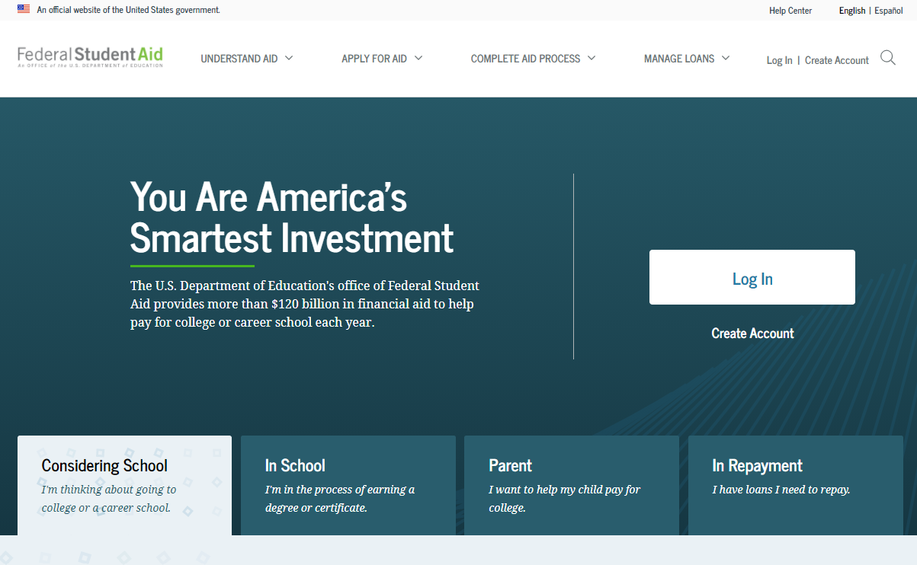
Studentaid.gov

Slide 16
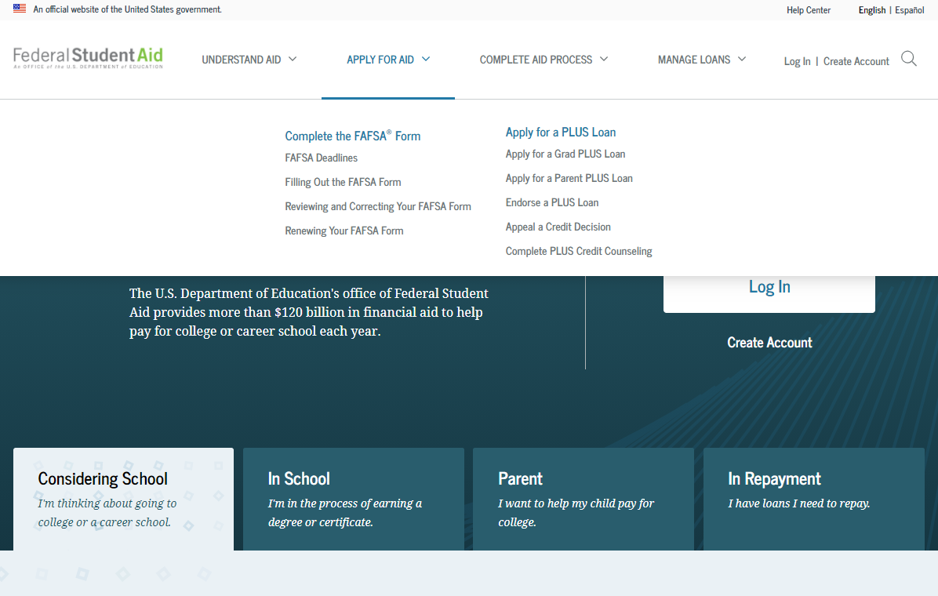
Apply for Aid

Slide 17
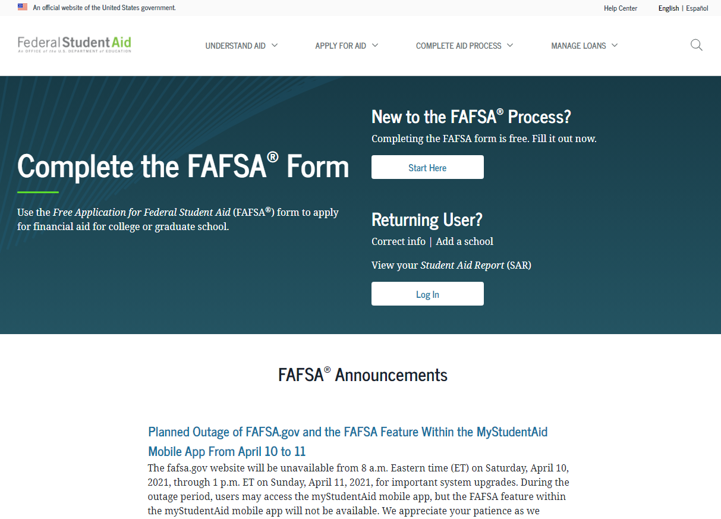
FAFSA

Slide 18
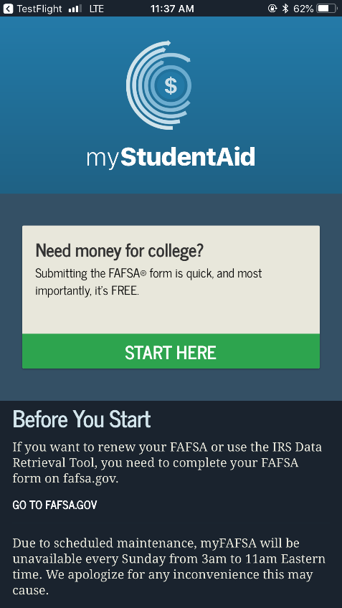
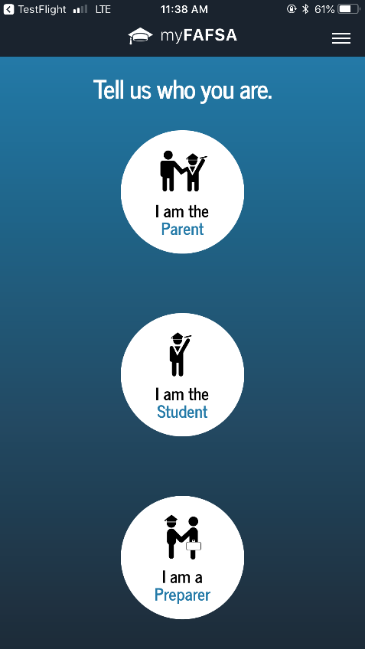
Mobile Ap
Mobile ability to begin, complete, save, and submit the FAFSA

Slide 19
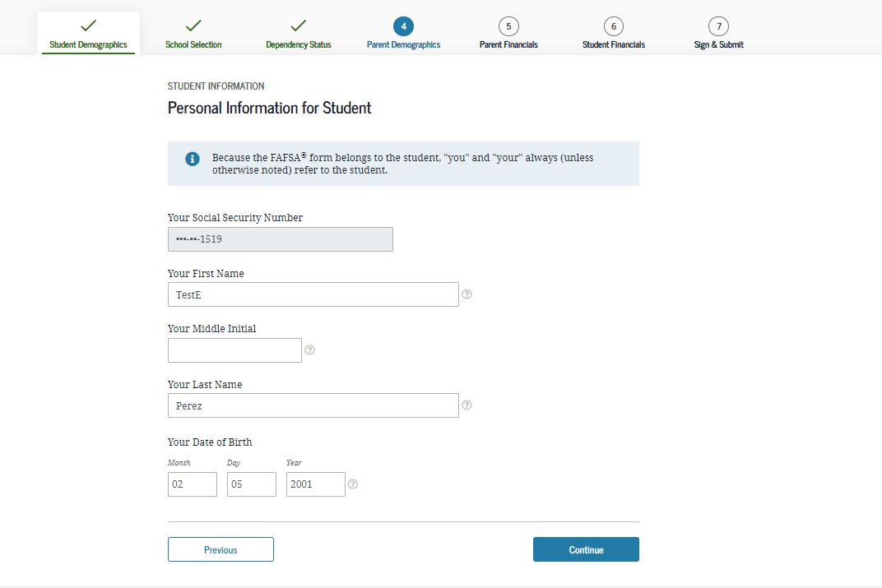
Student Demographics
Students must use their LEGAL name
Social Security Number
Date of Birth

Slide 20
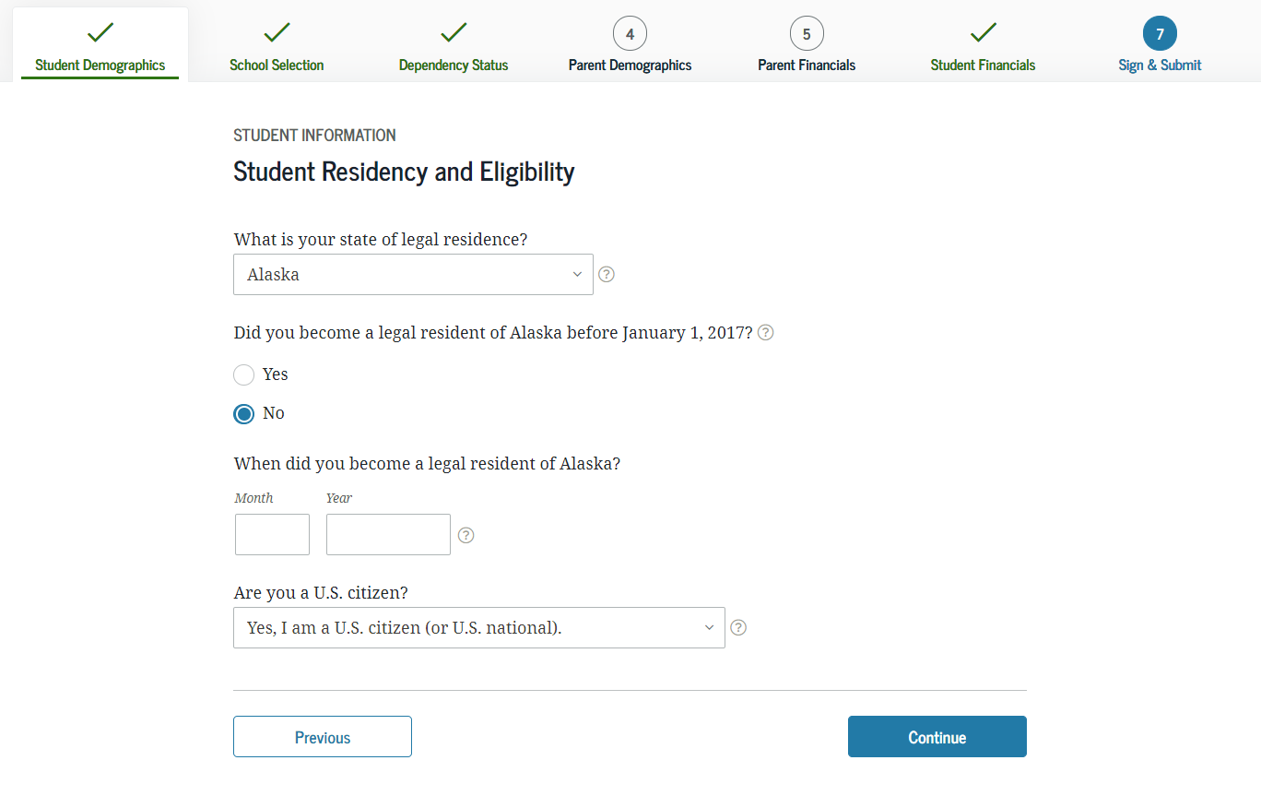
Student Eligibility
Citizenship
US Citizens will have an SSN tied to their legal name
Eligible Non-Citizens will have both an SSN & Alien Registration Number
Grade Level
Not Graduate Students or Seniors
Degree they are seeking
Associate, Bachelor before Master’s or PhD
Foster Care

Slide 21
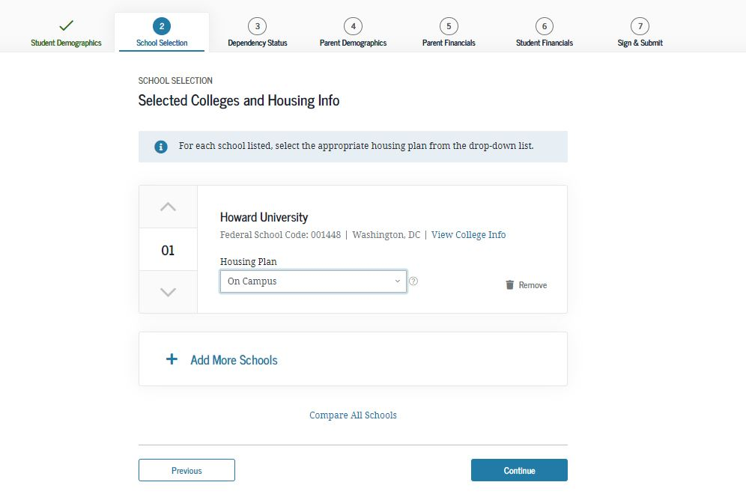
Colleges & Housing
Students can select up to 10 colleges to receive their FAFSA results
Housing Questions
Helps to determine Cost of Attendance
At Home with Parents
On-Campus
Off-Campus
You can change your mind

Slide 22
Dependency
Born before Jan. 1, 1999
Veteran
Active duty - military
Married
Children or other dependents
Both parents deceased
Foster care past age 13
Dependent/ward of court past age 13
Legal guardianship
Emancipated minor
Homeless or at risk of homelessness
Graduate student
If the answer to all is NO – they’re Dependent
If the answer to ANY is YES – they’re Independent

Slide 23
Parent Information
Who is my parent when it comes to the FAFSA?
If parents are living together, regardless of marital status, include their combined financial information
This includes same-sex partners
If parents are divorced or separated, include the financial information for the parent you lived with more during the past 12 months. If that parent is remarried, you must include your stepparent’s financial information.
Grandparents, foster parents, and legal guardians are NOT considered parents unless they legally adopted you

Slide 24
Items Needed
2021 Taxes, Income information, benefit summaries
Asset information
NOT 401(k) or IRA balances
NOT the value of your primary residence
Untaxed income such as child support received

Slide 25
IRS Data Retrieval
Real-time request in the FAFSA to import IRS tax data
Important! You will not see the actual IRS data on the IRS website or inserted into the FAFSA.
Reduces documents requested later.
Parents filing a joint tax return will need to enter income from work manually on the FAFSA.
IRS DRT will not work for families who:
Do not have a Social Security Number
Are married but file taxes separately

Slide 26
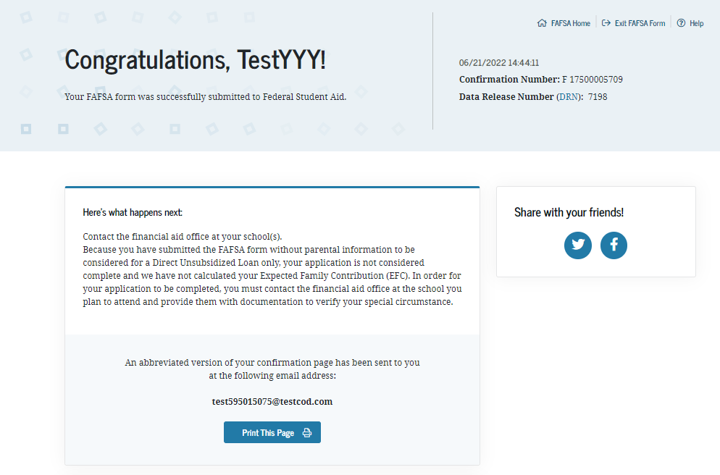
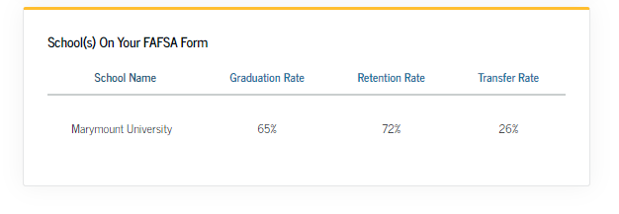
Confirmation

Slide 27
Common Mistakes
Social Security numbers
Divorced/remarried parental information
Income earned by parents/stepparents
Untaxed income
U.S. income taxes paid
Household size
Number of household members in college
Real Estate and investment net worth
What assets to include
Make corrections online at studentaid.gov
or on the paper Student Aid Report

Slide 28
After you File
A summary of your application is created for your review & sent to your selected schools electronically
Summary is called a Student Aid Report (SAR)
Students with FSA IDs may view SAR online at studentaid.gov
If schools require further information or documentation, they will contact the student directly
Make sure students know how each school communicates with them
FERPA
Watch for award notifications
Many schools won’t begin awarding aid for 2022-2023 until late December or January.

Slide 29
Special Circumstances
Secondary school tuition
Unusual uncovered medical/dental expenses
Extraordinary dependent care
Parent or spouse death
Loss of employment
Divorce

Slide 30
Special Circumstances
Cannot be documented using FAFSA
Change in employment status
Unusual medical expenses not covered by insurance
Change in parent marital status
Work with your college
Written explanation and documentation
College will review and request additional information if necessary
Decisions are final and cannot be appealed to U.S. Department of Education

Slide 31
Satisfactory Academic Progress (SAP)
Undergraduate Student Standards
Time Frame
150% of required credit hours attempted at all institutions
Grade Point Average
2.0 for Cumulative Credit Hours
Pace
Must complete 67% or more of hours attempted over the history of their undergraduate college credits

Slide 32
Scholarships
Scholarships are considered “gift aid” similar to grants
Some have restrictions on what they will pay
Direct costs only?
Are there enrollment restrictions?
They come from multiple sources
Institutions
Organizations
Employers
The list is growing every day

Slide 33
Scholarships
Institutions
Is there an application?
Are there MULTIPLE applications?
When do I apply?
What is the deadline?
Is it based on Merit or Need?
What do they need to determine eligibility?
Does it require follow-up?
Is it renewable?
What are the requirements for renewal?

Slide 34
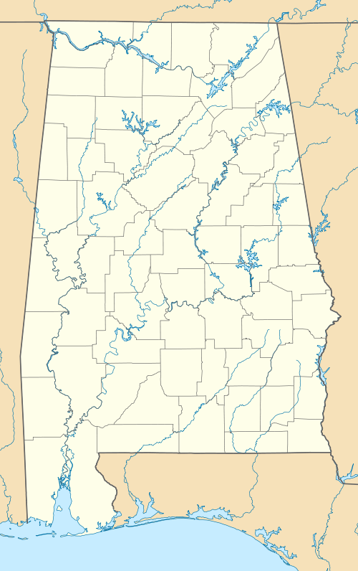
Alabama State Programs
Alabama Student Grant
Alabama Student Assistant Program
Alabama National Guard Educational Assistance Program
Alabama Math & Science Teacher Education Program
Police Officer’s & Firefighter’s Survivor’s Educational Assistance Program

Slide 35
Next Steps
Obtain and review admissions and financial aid Web sites and materials for each school to which you are applying.
Meet all application deadlines.
Complete FAFSA and other application materials. Submit all requested follow-up documents.
Investigate other sources of aid.

Slide 36
Questions?

